Slide 1
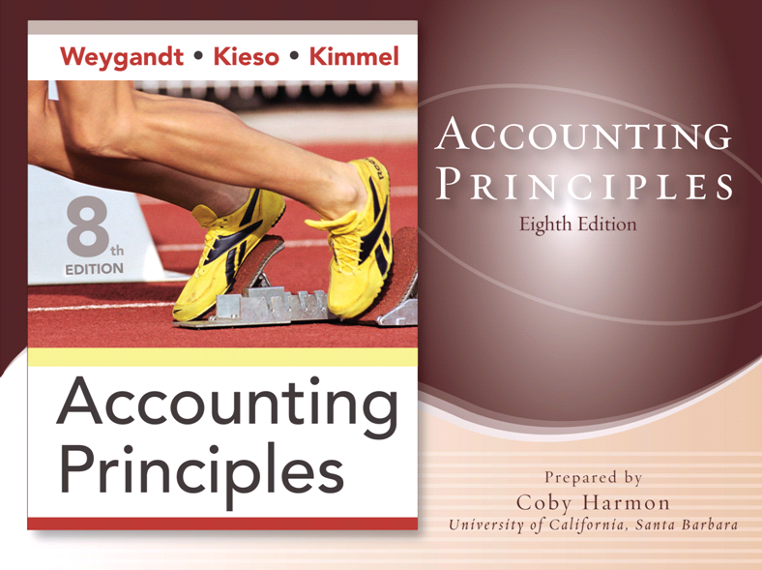

Slide 2
CHAPTER 2
THE RECORDING PROCESS
Accounting Principles, Eighth Edition

Slide 3
Study Objectives
Explain what an account is and how it helps in the recording process.
Define debits and credits and explain their use in recording business transactions.
Identify the basic steps in the recording process.
Explain what a journal is and how it helps in the recording process.
Explain what a ledger is and how it helps in the recording process.
Explain what posting is and how it helps in the recording process.
Prepare a trial balance and explain its purposes.
Notes:
1. On the topic, “Challenges Facing Financial Accounting,” what did the AICPA Special Committee on Financial Reporting suggest should be included in future financial statements?
Non-financial Measurements (customer satisfaction indexes, backlog information, and reject rates on goods purchases).
Forward-looking Information
Soft Assets (a company’s know-how, market dominance, marketing setup, well-trained employees, and brand image).
Timeliness (no real time financial information)

Slide 4

The Recording Process
The Account
Steps in the Recording Process
The Recording Process Illustrated
The Trial Balance
Debits and credits
Expansion of basic equation
Journal
Ledger
Summary illustration of journalizing and posting
Limitations of a trial balance
Locating errors
Notes:
Service Cost - Actuaries compute service cost as the present value of the new benefits earned by employees during the year. Future salary levels considered in calculation.
Interest on Liability - Interest accrues each year on the PBO just as it does on any discounted debt.
Actual Return on Plan Assets - Increase in pension funds from interest, dividends, and realized and unrealized changes in the fair market value of the plan assets.
Amortization of Unrecognized Prior Service Cost - The cost of providing retroactive benefits is allocated to pension expense in the future, specifically to the remaining service-years of the affected employees.
Gain or Loss - Volatility in pension expense can be caused by sudden and large changes in the market value of plan assets and by changes in the projected benefit obligation. Two items comprise the gain or loss:
difference between the actual return and the expected return on plan assets and,
amortization of the unrecognized net gain or loss from previous periods

Slide 5
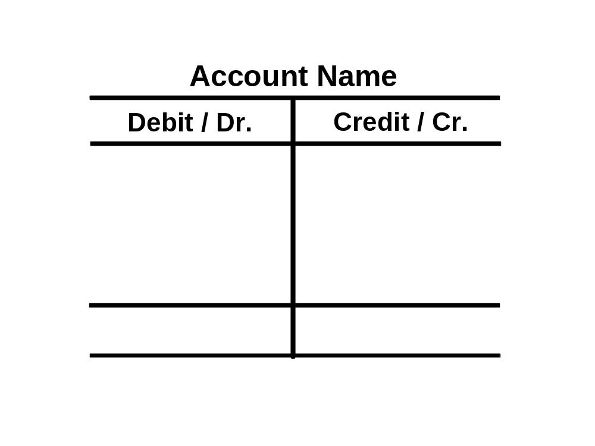

The Account
Record of increases and decreases in a specific asset, liability, equity, revenue, or expense item.
Debit = “Left”
Credit = “Right”
Account
An Account can be illustrated in a T-Account form.
LO 1 Explain what an account is and how it helps in the recording process.

Slide 6
Having debits on the left and credits on the right is an accounting custom/rule. This rule applies to all accounts.

Slide 7

Debits and Credits
If Debits are greater than Credits, the account will have a debit balance.
Transaction #1
$10,000
$3,000
Transaction #2
Transaction #3
8,000
Balance
$15,000
LO 2 Define debits and credits and explain their use in recording business transactions.

Slide 8
Debits and Credits
If Credits are greater than Debits, the account will have a credit balance.
Transaction #1
$10,000
$3,000
Transaction #2
8,000
Transaction #3
Balance
$1,000
LO 2 Define debits and credits and explain their use in recording business transactions.

Slide 9
Debits and Credits
Double-entry accounting system
Each transaction must affect two or more accounts to keep the basic accounting equation in balance.
Recording done by debiting at least one account and crediting another.
DEBITS must equal CREDITS.
LO 2 Define debits and credits and explain their use in recording business transactions.

Slide 10
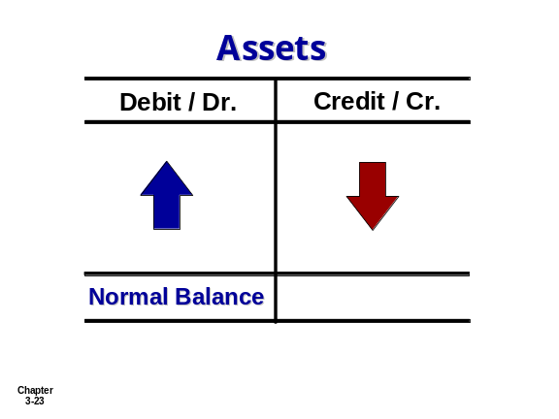
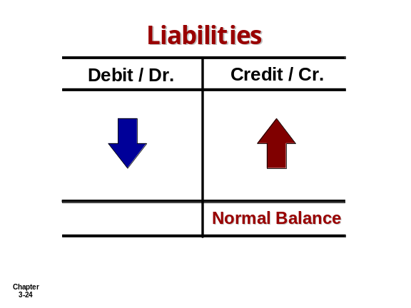
Assets and Liabilities
Assets - Debits should exceed credits.
Liabilities – Credits should exceed debits.
The normal balance is on the increase side.
LO 2 Define debits and credits and explain their use in recording business transactions.

Slide 11
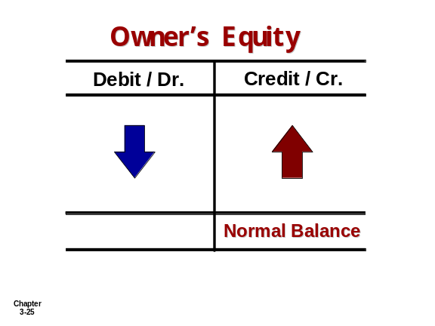
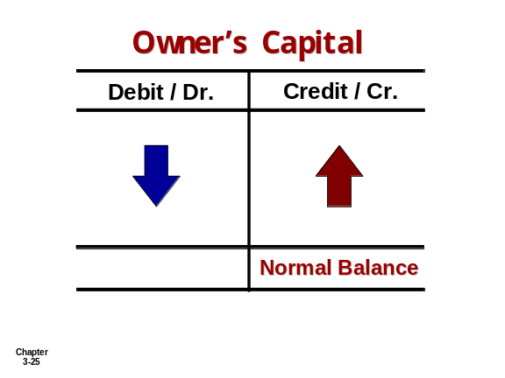
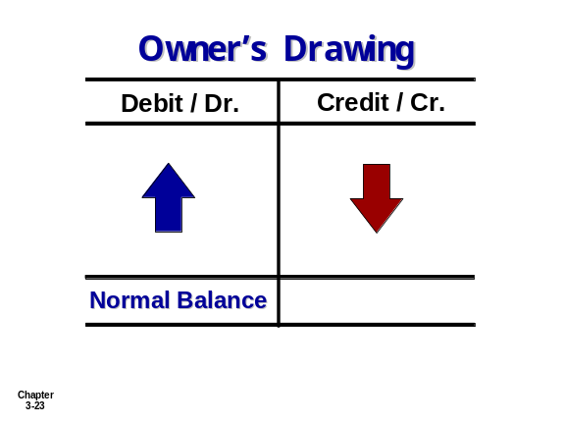
Owners’ Equity
Owner’s investments and revenues increase owner’s equity (credit).
Owner’s drawings and expenses decrease owner’s equity (debit).
LO 2 Define debits and credits and explain their use in recording business transactions.

Slide 12
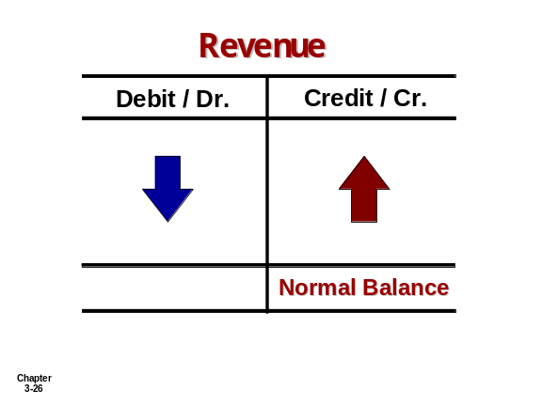
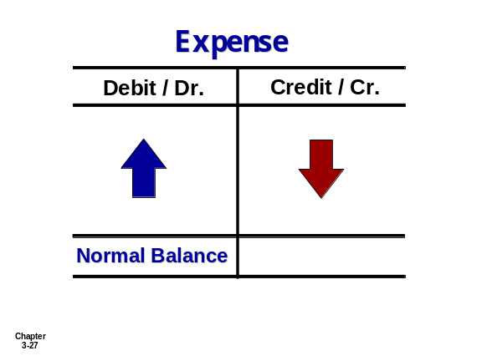
Revenue and Expense
The purpose of earning revenues is to benefit the owner(s).
The effect of debits and credits on revenue accounts is the same as their effect on Owner’s Capital.
Expenses have the opposite effect: expenses decrease owner’s equity.
LO 2 Define debits and credits and explain their use in recording business transactions.

Slide 13

Debits and Credits Summary
Normal Balance Debit
Normal Balance Credit
LO 2

Slide 14


Debits and Credits Summary
Balance Sheet Income Statement
Asset
Liability
+
-
=
Equity
Revenue
Expense
Debit
Credit
LO 2 Define debits and credits and explain their use in recording business transactions.

Slide 15
Debits and Credits Summary
Review Question
Debits:
  increase both assets and liabilities.
  decrease both assets and liabilities.
  increase assets and decrease liabilities.
  decrease assets and increase liabilities.
LO 2 Define debits and credits and explain their use in recording business transactions.

Slide 16
Debits and Credits Summary
Review Question
Accounts that normally have debit balances are:
  assets, expenses, and revenues.
  assets, expenses, and owner’s capital.
  assets, liabilities, and owner’s drawings.
  assets, owner’s drawings, and expenses.
LO 2 Define debits and credits and explain their use in recording business transactions.

Slide 17
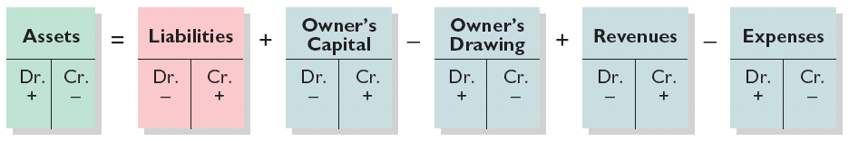
Expansion of the Basic Equation
Relationship among the assets, liabilities and owner’s equity of a business:
Basic Equation
Illustration 2-11
Assets
=
Liabilities
+
Owner’s Equity
Expanded Basic Equation
The equation must be in balance after every transaction. For every Debit there must be a Credit.
LO 2 Define debits and credits and explain their use in recording business transactions.

Slide 18
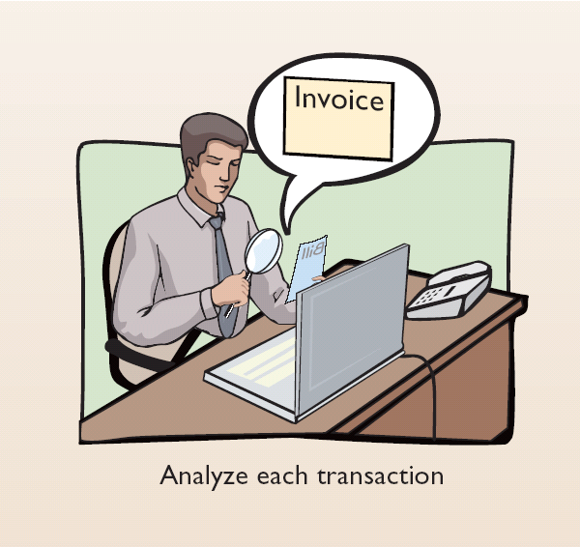
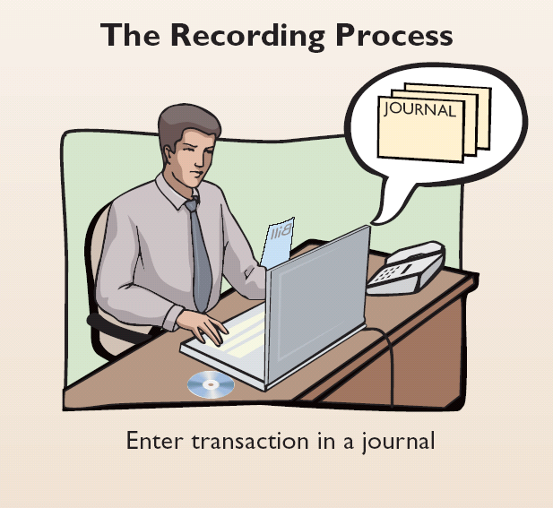
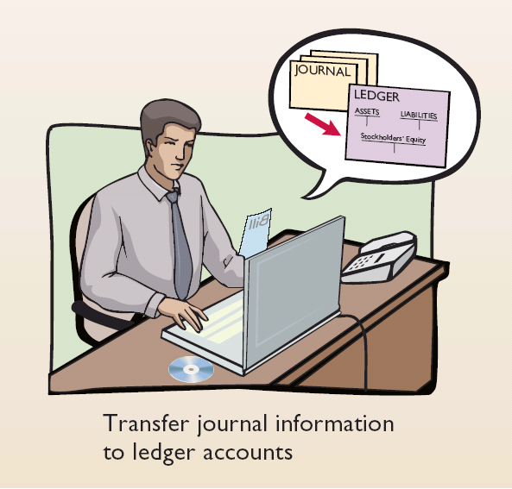
Steps in the Recording Process
Illustration 2-12
Analyze each transaction
Enter transaction in a journal
Transfer journal information to ledger accounts
Business documents, such as a sales slip, a check, a bill, or a cash register provide evidence of the transaction.
LO 3 Identify the basic steps in the recording process.

Slide 19
Exercise
E2-2 Selected transactions for D Reyes , an interior decorator. In her first month of business, are as follows.
Jan. 2 Invested $10,000 cash in business.
3 Purchased used car for $4,000 cash for use in business.
9 Purchased supplies on account for $500.
11 Billed customers $1,800 for services performed.
16 Paid $200 cash for advertising.
20 Received $700 cash from customers billed on January 11.
23 Paid creditor $300 cash on balance owed.
28 Withdrew $1,000 cash for personal use by owner.
Instructions : For each transactions indicate the following:
a) The basic type of account debited and credited (asset, liability, owner’s equity)
b) The specific account debited and credited (cash, rent expense, service revenue etc.)
c) Whether the specific account is increased and decreased.
d) The normal balance of the specific account.

Slide 20
The Journal
Book of original entry.
Transactions recorded in chronological order.
Contributions to the recording process:
  Discloses the complete effects of a transaction.
  Provides a chronological record of transactions.
  Helps to prevent or locate errors because the debit and credit amounts can be easily compared.
LO 3 Identify the basic steps in the recording process.

Slide 21
Journalizing
Journalizing - Entering transaction data in the journal.
E2-4 (Facts) Presented below is information related to Hanshew Real Estate Agency.
Oct. 1
Pete Hanshew begins business as a real estate agent with a cash investment of $15,000.
3
Purchases office furniture for $1,900, on account.
6
Sells a house and lot for B. Kidman; bills B. Kidman $3,200 for realty services provided.
27
Pays $700 on balance related to transaction of Oct. 3.
30
Pays the administrative assistant $2,500 salary for Oct.
E2-5 Instructions - Journalize the transactions for E2-4.
LO 4 Explain what a journal is and how it helps in the recording process.

Slide 22
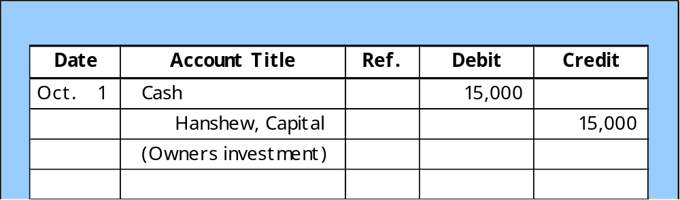
Journalizing
E2-4 (Facts) Presented below is information related to Hanshew Real Estate Agency.
Oct. 1
Pete Hanshew begins business as a real estate agent with a cash investment of $15,000.
General Journal
LO 4 Explain what a journal is and how it helps in the recording process.

Slide 23
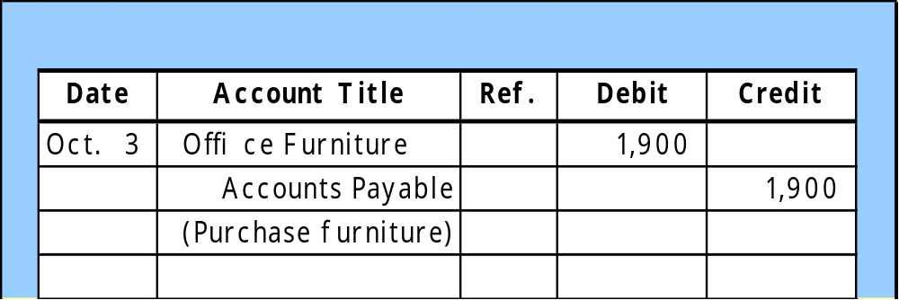
Journalizing
E2-4 (Facts) Presented below is information related to Hanshew Real Estate Agency.
Oct. 3
Purchases office furniture for $1,900, on account.
General Journal
LO 4 Explain what a journal is and how it helps in the recording process.

Slide 24
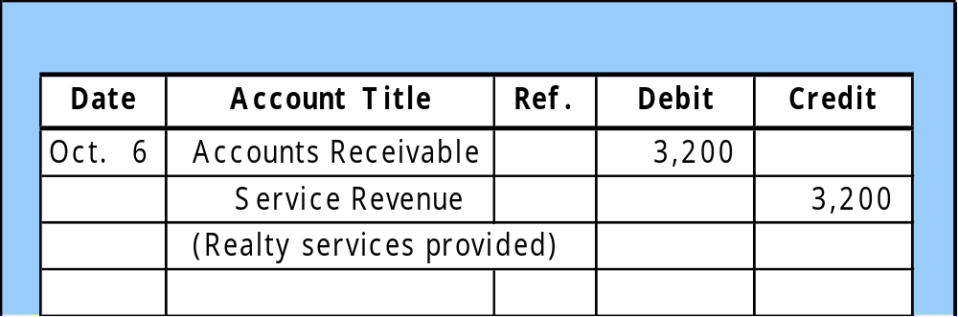
Journalizing
E2-4 (Facts) Presented below is information related to Hanshew Real Estate Agency.
Oct. 6
Sells a house and lot for B. Kidman; bills B. Kidman $3,200 for realty services provided.
General Journal
LO 4 Explain what a journal is and how it helps in the recording process.

Slide 25
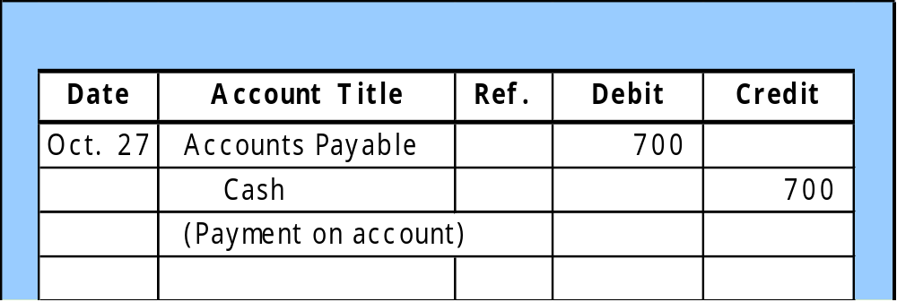
Journalizing
E2-4 (Facts) Presented below is information related to Hanshew Real Estate Agency.
Oct. 27
Pays $700 on balance related to transaction of Oct. 3.
General Journal
LO 4 Explain what a journal is and how it helps in the recording process.

Slide 26
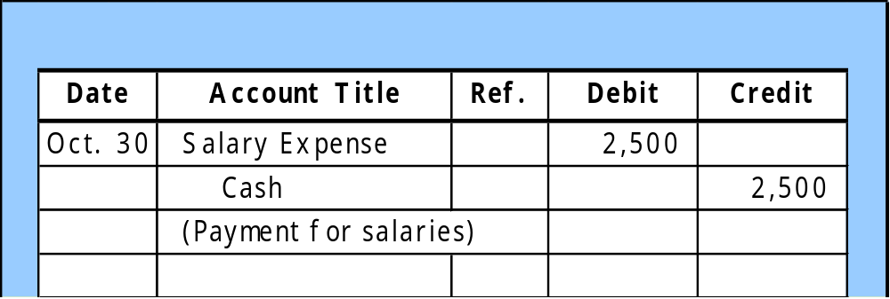
Journalizing
E2-4 (Facts) Presented below is information related to Hanshew Real Estate Agency.
Oct. 30
Pays the administrative assistant $2,500 salary for Oct.
General Journal
LO 4 Explain what a journal is and how it helps in the recording process.

Slide 27
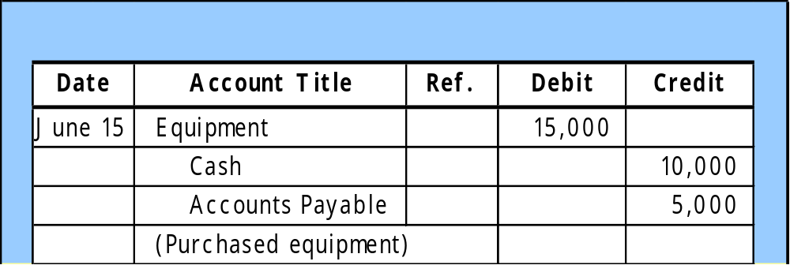
Journalizing
Simple Entry – Two accounts, one debit and one credit.
Compound Entry – Three or more accounts.
Example – On June 15, H. Burns, purchased equipment for $15,000 by paying cash of $10,000 and the balance on account (to be paid within 30 days).
General Journal
LO 4 Explain what a journal is and how it helps in the recording process.

Slide 28
The Ledger
A General Ledger contains the entire group of accounts maintained by a company.
The General Ledger includes all the asset, liability, owner’s equity, revenue and expense accounts.
LO 5 Explain what a ledger is and how it helps in the recording process.

Slide 29
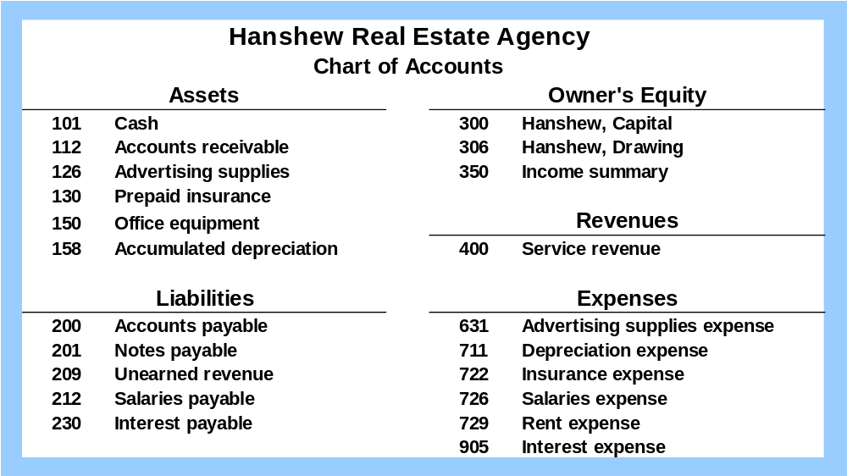
Chart of Accounts
Accounts and account numbers arranged in sequence in which they are presented in the financial statements.
LO 6 Explain what posting is and how it helps in the recording process.

Slide 30
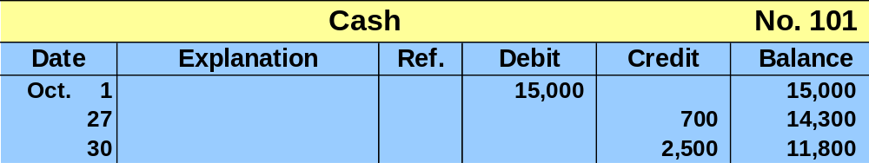
Standard Form of Account
T-account form used in accounting textbooks.
In practice, the account forms used in ledgers are
much more structured.
LO 5 Explain what a ledger is and how it helps in the recording process.

Slide 31
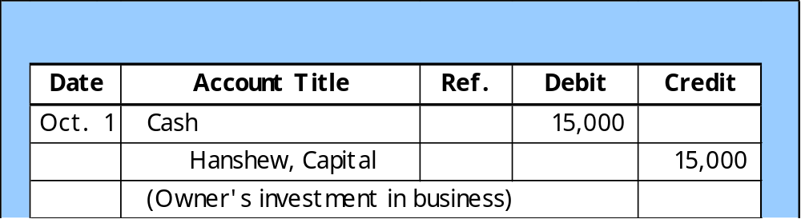
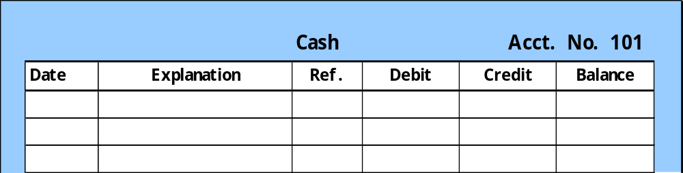
Posting
Posting – the process of transferring amounts from the journal to the ledger accounts.
General Journal
J1
101
General Ledger
Oct. 1
J1
15,000
15,000
LO 6 Explain what posting is and how it helps in the recording process.

Slide 32
Posting
Review Question
Posting:
  normally occurs before journalizing.
  transfers ledger transaction data to the journal.
  is an optional step in the recording process.
  transfers journal entries to ledger accounts.
LO 6 Explain what posting is and how it helps in the recording process.

Slide 33
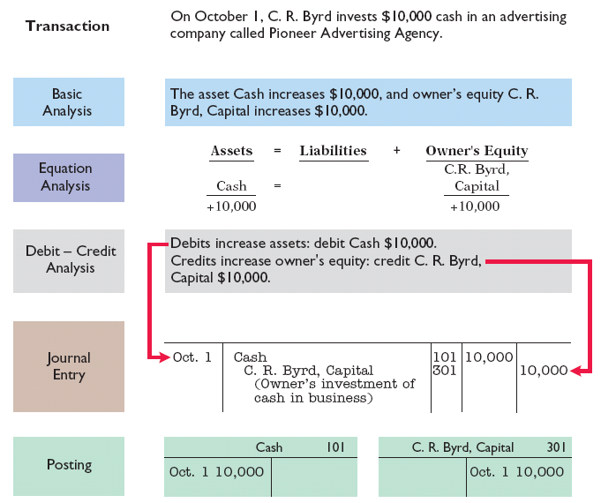
The Recording Process Illustrated
Follow these steps:
1. Determine what type of account is involved.
2. Determine what items increased or decreased and by how much.
3. Translate the increases and decreases into debits and credits.
Illustration 2-19
LO 6 Explain what posting is and how it helps in the recording process.

Slide 34
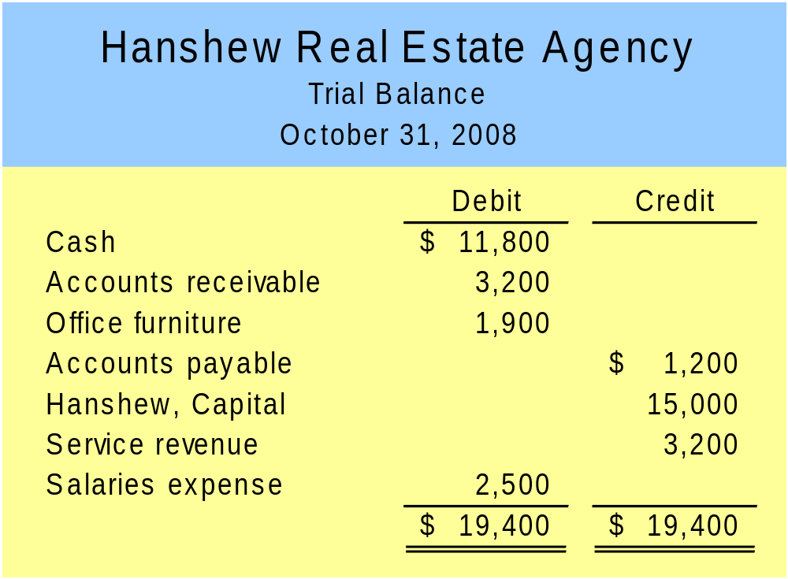
The Trial Balance
A list of accounts and their balances at a given time.
Purpose is to prove that debits equal credits.
LO 7 Prepare a trial balance and explain its purposes.

Slide 35
The Trial Balance
Limitations of a Trial Balance
The trial balance may balance even when
  a transaction is not journalized,
  a correct journal entry is not posted,
  a journal entry is posted twice,
  incorrect accounts are used in journalizing or posting, or
  offsetting errors are made in recording the amount of a transaction.
LO 7 Prepare a trial balance and explain its purposes.

Slide 36
The Trial Balance
Review Question
A trial balance will not balance if:
  a correct journal entry is posted twice.
  the purchase of supplies on account is debited to Supplies and credited to Cash.
  a $100 cash drawing by the owner is debited to Owner’s Drawing for $1,000 and credited to Cash for $100.
  a $450 payment on account is debited to Accounts Payable for $45 and credited to Cash for $45.
LO 7 Prepare a trial balance and explain its purposes.

Slide 37
Recording Process
Discussion Question
Q2-19. Jim Benes is confused about how accounting information flows through the accounting system. He believes the flow of information is as follows.
  Debits and credits posted to the ledger.
  Business transaction occurs.
  Information entered in the journal.
  Financial statements are prepared.
  Trial balance is prepared.
Is Jim correct? If not, indicate to Jim the proper flow of the information.
LO 7 Prepare a trial balance and explain its purposes.
Notes:
Question 2-19 (textbook) No, Jim is not correct . The proper sequence is as follows :
( b ) Business transaction occurs.
( c ) Information entered in the journal.
( a ) Debits and credits are posted to the ledger.
( e ) Trial balance is prepared.
( d ) Financial statements are prepared.

Slide 38
Problem set A
2-2A Jane Kent is a licensed CPA. During the first month of operations of her business, the following events and transactions occurred.
May 1 Kent invested $25,000 cash.
2 Hired a secretary receptionist at a salary of $2,000 per month.
3 Purchased $2,500 of supplies on account from Read Supply Co.
7 Paid office rent of $900 cash for the month.
11 Completed a tax assignment and billed client $2,100 for services provided.
12 Received $3,500 advance on a management consulting engagement.
17 Received cash of $1,200 for services completed for H. Arnold Co.
31 Paid secretary receptionist $2,000 salary for the month.
31 Paid 40% of balance due Read Supply Co.

Slide 39
Jane uses the following chart of accounts:
No. 101 Cash
112 Accounts receivable
126 Supplies
201 Accounts payable
205 Unearned revenue
301 Jane Kent, capital
400 Service revenue
726 Salaries expense
729 Rent expense
1. Journalize the transactions
2. Post to the ledger accounts.
3. Prepare a trial balance on May 31, 2008.

